Slide 1
Exploring NYPD Shootings Incidents: A Data Analysis using R Notebook
This presentation covers the analysis of NYPD Shootings Incidents from 2006 to 2021 using R Notebook. It includes data retrieval and cleaning, borough and year-wise shootings analysis, and statistical analysis. The presentation also includes visualizations in the form of bar charts, line charts, and insights gathered from the data.

Slide 2
Introduction
Objective: Analyzing NYPD Shootings Incidents from 2006 to 2021 using R Notebook.
Tools: R Notebook, knitr, tidyverse, lubridate, ggplot2.

Slide 3
Data Retrieval and Cleaning
Data Source: NYPD Shootings Incidents dataset from NYC Open Data.
Libraries Used: tidyverse, lubridate.
Data Cleaning Steps:
Selected relevant columns.
Converted date and time columns to appropriate formats.
Created a new variable for shootings.
Extracted the year from the date.

Slide 4
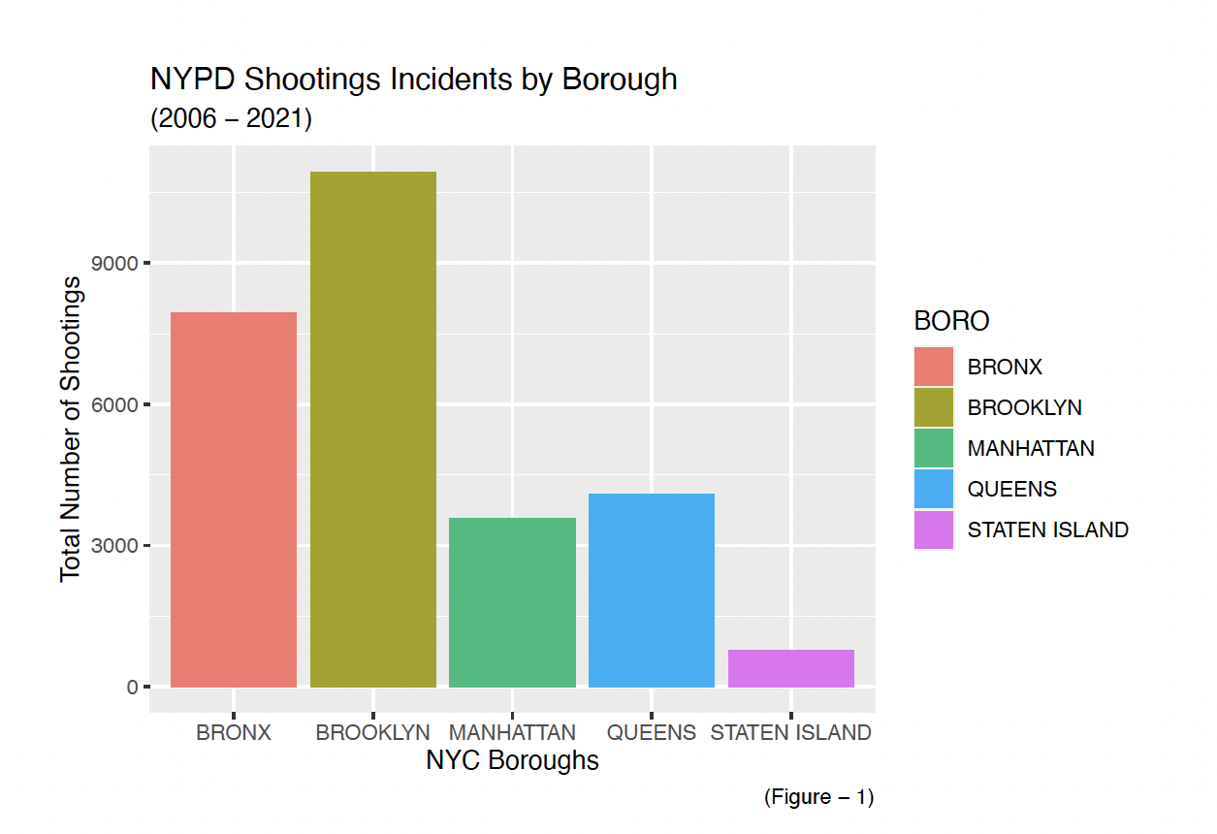
Shootings by Borough (Figure - 1)
total shootings by borough.
Brooklyn has the highest number of shootings.
Staten Island has the lowest number.

Slide 5
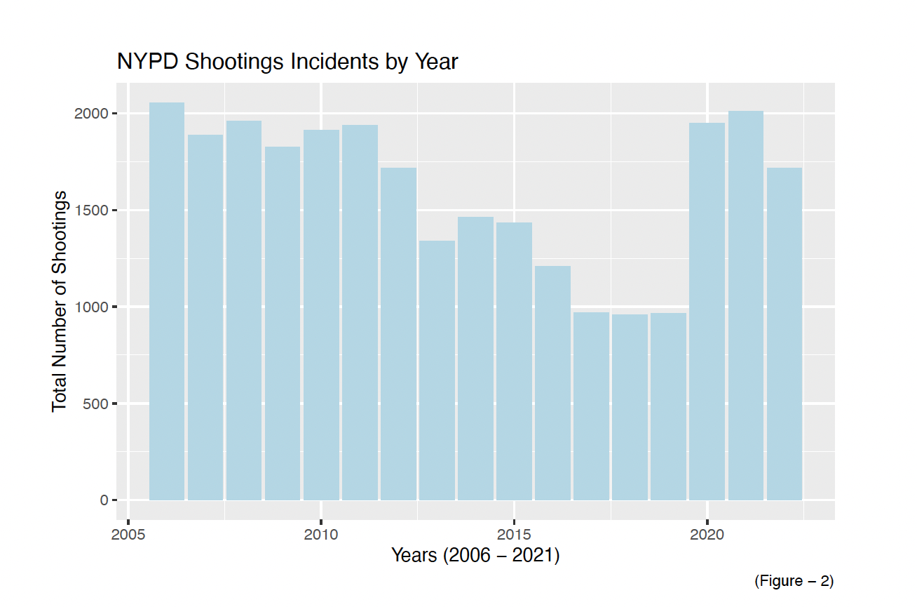
Shootings by Year
A gradual decline in last year.
Shootings peaked around 2006.

Slide 6
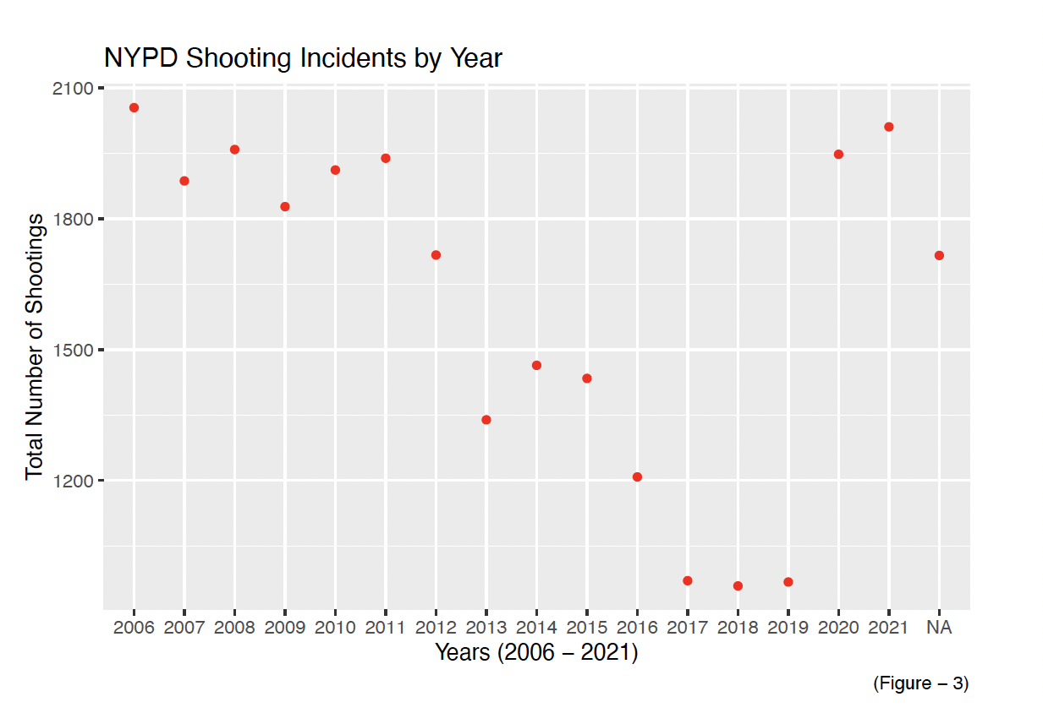
Shootings Trends Over Years (Figure - 3)
shootings trend over 2006-2021
Anomaly in 2020 and 2021 - Pandemic
Overall decreasing trend in shootings.

Slide 7
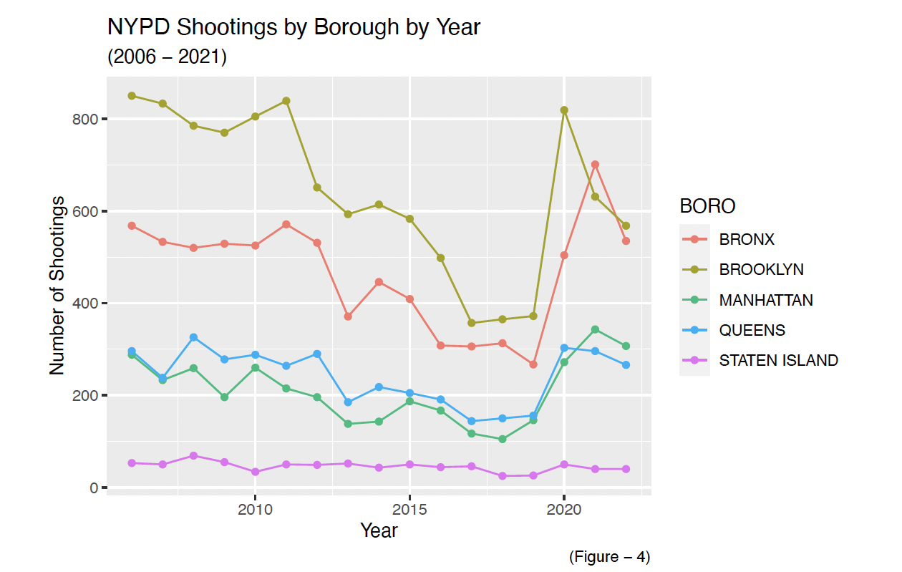
Borough-wise Shootings Over Time (Figure - 4)
Other boroughs show varying trends
Line chart depicting borough-wise shootings by year.
Brooklyn consistently has the highest shootings.
.

Slide 8
Statistical Analysis
65% of total shootings occurred in Brooklyn and Queens.
Only 2.7% of total shootings occurred in Staten Island.

Slide 9
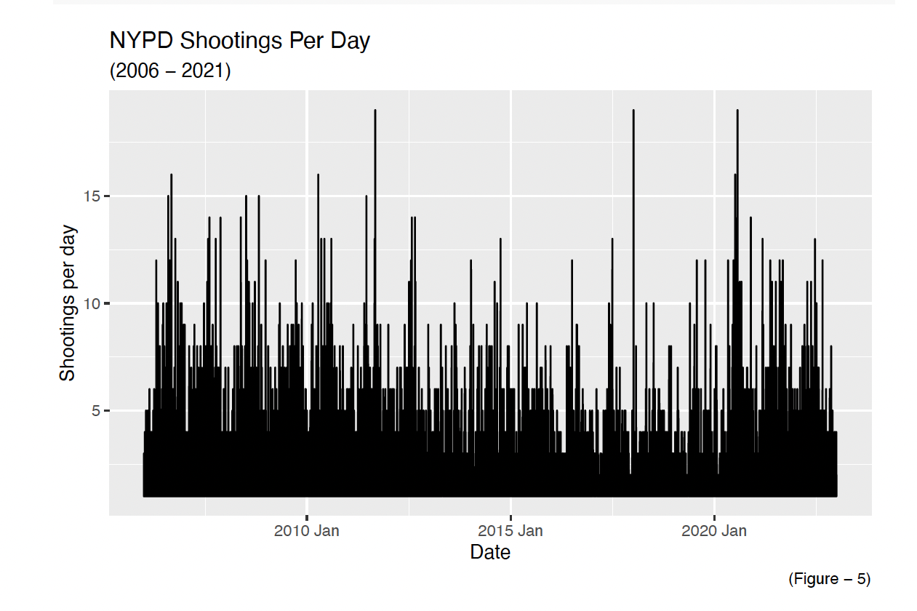
NYPD Shootings Per Day
daily count of shootings from 2006 to 2021.
Highest shooting days around July 4th, 2023.

Slide 10
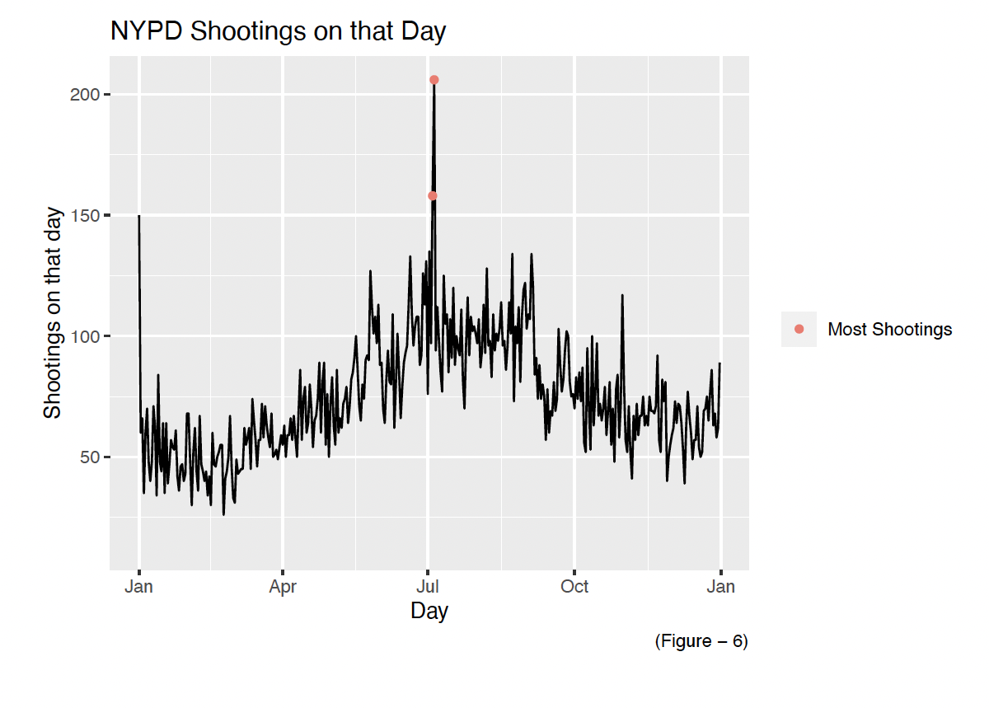
Shootings on July 5, 2023 (Figure - 6)
The second-highest shootings occurred on July 4, 2023.
July 5, 2023 had the highest number of shootings.

Slide 11
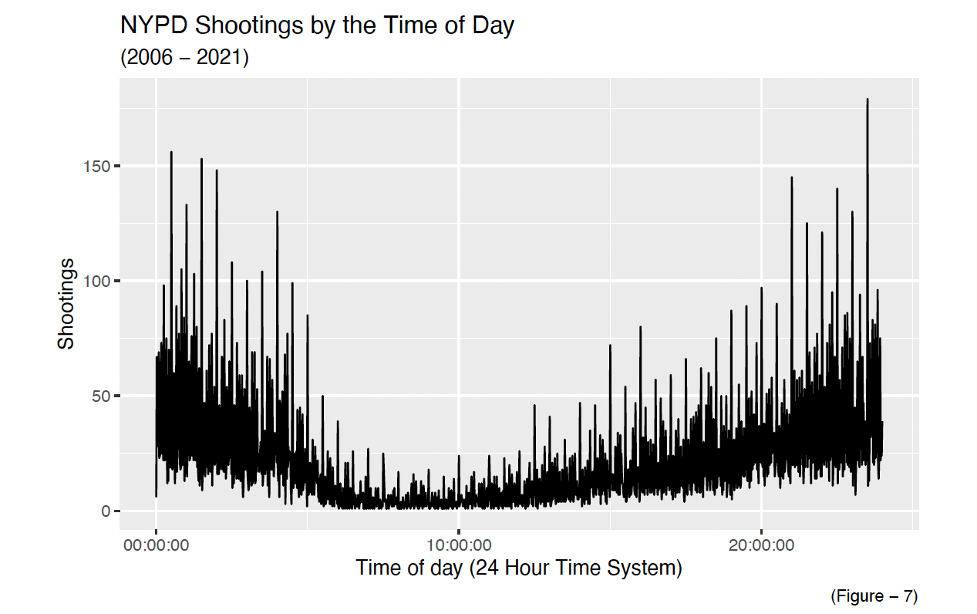
Shootings by Time of Day
Shootings less likely to occur between 5am and 3pm
Shootings most likely to occur between 8pm and 2am

Slide 12
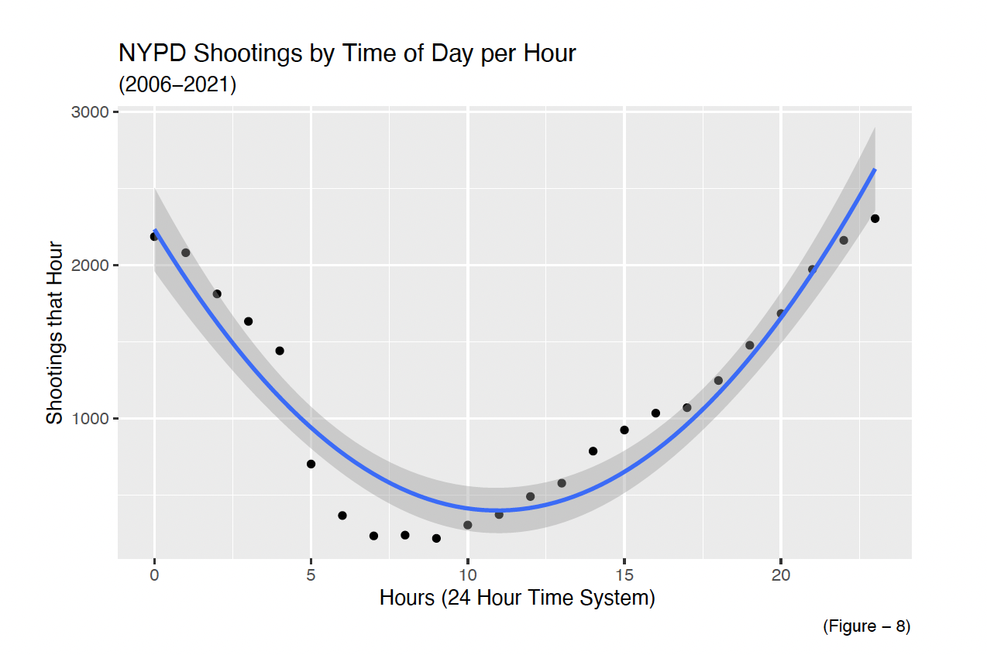
Shootings by Time of Day per Hour
Shootings less likely to occur between 5am and 3pm
Shootings most likely to occur between 8pm and 2am

Slide 13
Conclusion

